Slide 1

Guide name: Mr. Davesh Kumar Sharma ​ Designation: Assistant Professor ​ Department:
SRM INSTITUTE OF SCIENCE AND TECHNOLOGY ​
SCHOOL OF COMPUTING​
DEPARTMENT OF COMPUTER SCIENCE AND ENGINEERING​
​Progress Report on Plant Disease Detection
Using CNN
(Convolutional Neural Networks)
Batch ID: 243I014
​
Student1 Reg. No:RA2211003030370
Student 1 Name: Saksham Chaudhary
Student 2 Reg. No: RA2211003030387​
Student 2 Name: Rajat Garg
Student 3 Reg. No:RA2211003030405
Student 3 Name: Hakeem Ahrar Ahmad

Slide 2

Abstract
Recent advancements in plant disease detection have significantly improved through the application of Convolutional Neural Networks (CNN). This presentation reviews five key studies published post-2020 that utilize CNN and other deep learning techniques for detecting plant leaf diseases. The selected papers collectively explore various methodologies, including YOLOv4 for real-time detection and transfer learning approaches, highlighting their effectiveness in achieving high accuracy and efficiency. These studies not only underline the importance of deep learning in agricultural practices but also provide insights into challenges and future directions for research in this domain.

Slide 3
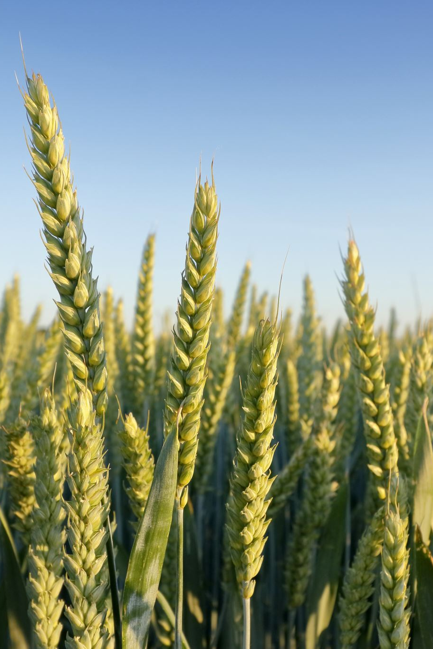
Introduction
• Agriculture's productivity is critically affected by plant diseases.
• Traditional methods of detection are slow, labor-intensive, and prone to errors.
• CNNs are powerful tools in image classification, ideal for detecting diseases through leaf images.
• Automated detection can save crops and improve global food security.

Slide 4
Literature Review
Paper 1: "Convolutional Neural Networks in Detection of Plant Leaf Diseases: A Review"Comprehensive overview of CNN applicationsSummary of advancements and challenges
Paper 2: "Detection and identification of plant leaf diseases using YOLOv4". Implementation of YOLOv4 algorithmHigh accuracy in disease detection
Paper 3: "Plant diseases and pests detection based on deep learning: a review". Overview of deep learning techniquesFocus on detection of both diseases and pests
Paper 4: "Automatic detection of plant diseases using deep learning". Discussion of various deep learning techniques Benefits of automatic detection systems
Paper 5: "A deep learning approach for detection of plant leaf diseases". Novel deep learning model for leaf disease detection Comparison with traditional methods

Slide 5
Problem Statement
• Traditional detection methods are time-consuming and prone to human error.
• Large-scale monitoring for plant diseases is a challenge without automation.
• Farmers require fast, reliable, and affordable tools for disease detection.

Slide 6
Proposed System
• Dataset: Plant Village, consisting of diseased and healthy leaf images.
• Model Architecture: VGG-19 CNN used for feature extraction and classification.
• Image Preprocessing: Data augmentation and normalization using Keras' Image Data Generator.
• Deployment: Model deployed on a mobile app for real-time disease detection.

Slide 7
Future Work
• Expand the dataset to cover more species and disease types.
• Improve the CNN architecture for enhanced accuracy.
• Field testing to ensure real-world performance matches lab results.
• Continue enhancing the mobile app's scalability and performance.

Slide 8
References
https://www.mdpi.com/2077-0472/12/8/1192
https://www.frontiersin.org/journals/plant-science/articles/10.3389/fpls.2024.1355941/full
https://plantmethods.biomedcentral.com/articles/10.1186/s13007-021-00722-9
https://www.researchgate.net/publication/344155605_Plant_Disease_Detection_using_CNN
https://www.sciencedirect.com/science/article/pii/S1879729619301437

Slide 9

Questions

